Slide 1
Introduction to WORLD RELIGIONS
How have religions influenced human society?

Slide 2
Which religions arose in the Middle East?
Judaism
Christianity
Islam

Slide 3
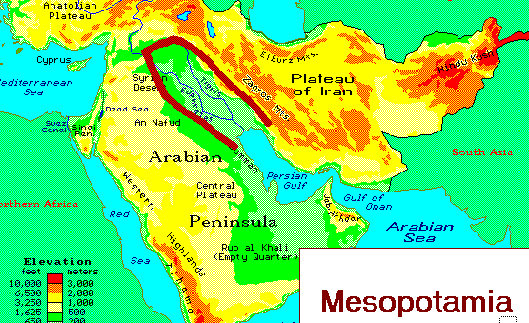
Judaism: Origins & Development
Judaism begins with Abraham (born 4,000 years ago in Mesopotamia).

Slide 4
According to Jewish Scripture…
God visited Abraham and made a sacred covenant with him.
WHAT IS A COVENANT?
A covenant is a sacred agreement.

Slide 5
What sacred agreement did God make with Abraham?
Abraham promised that he and his descendants would follow God’s teachings.
God promised to love and care for them.
Abraham’s descendants are called ISRAELITES or HEBREWS.

Slide 6
What are the beliefs of Judaism?
Jews follow the TORAH.
What is the” TORAH? the 1st five books of the Hebrew Bible create the TORAH.
The 10 Commandments are a part of the Torah.
Jews created the idea of MONOTHEISM based on the 1st Commandment.
“You shall have no other gods before Me.”
Monotheism – belief in one god
Polytheism – belief in many gods

Slide 7
Let’s learn more about Judiasm:
http://www.youtube.com/watch?v=HyEaAcPGAhA

Slide 8
Christianity:
The 2nd world religion to emerge in the Middle East was Christianity.
The early Christians were Jews.
Christianity follows the teachings of
Jesus Christ.
Christians believe Jesus was the son of God.

Slide 9
New Testament of the Bible…
The teachings of Christ are contained in the New Testament of the Bible.
The Bible says Jesus was put to death by crucifixion around 30 CE.
Christians believe Jesus rose from the dead after 3 days. This is called the RESURRECTION.

Slide 10
What do Christian’s believe?
Christians follow the Bible.
There are 2 parts to the Bible – the Old Testament and the New Testament.
Christians believe Jesus rose from
the dead and sits in Heaven by God.
Christians follow rituals they call SACRAMENTS (example – baptism & communion).

Slide 11
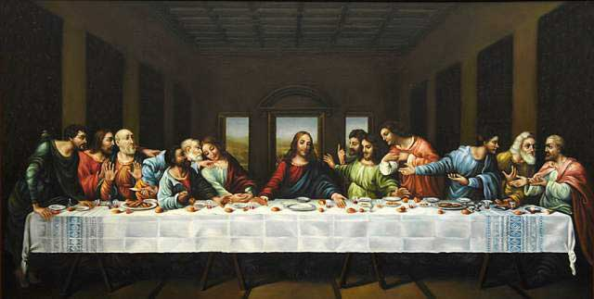
Painting of the Last Supper:

Slide 12
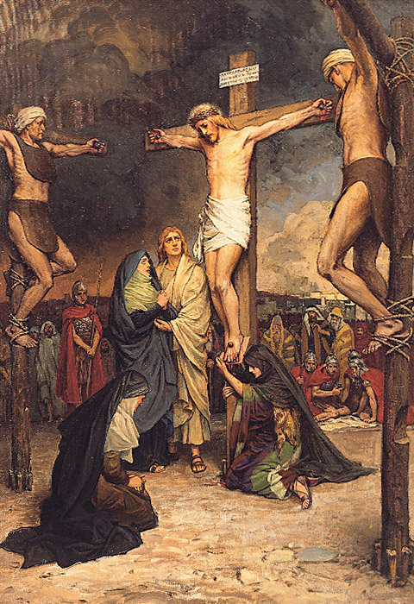
Image of the Crucifixion of Christ:

Slide 13
Let’s learn more about Christianity:
https://www.youtube.com/watch?v=pKr2G5fYdi8

