Slide 1
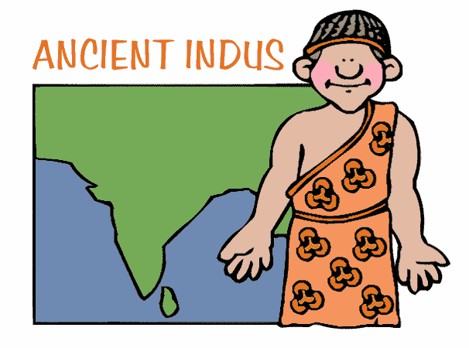
Indus River Valley
Mrs. McKay

Slide 2
Review
Rivers
Names, Geographic Features
Writing Systems
Nomads
Architecture-Buildings
What was their purpose?

Slide 3
What We Will Learn Today:
How did geography effect the Indus River Valley civilization?

Slide 4
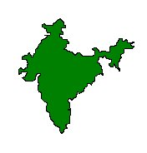
India’s Geographic Features
The Indian subcontinent is a large, wedge-shaped peninsula that extends southward into the Indian Ocean.
Subcontinent: A large region that is part of a continent, but is separated from the rest of the content in some way.

Slide 5
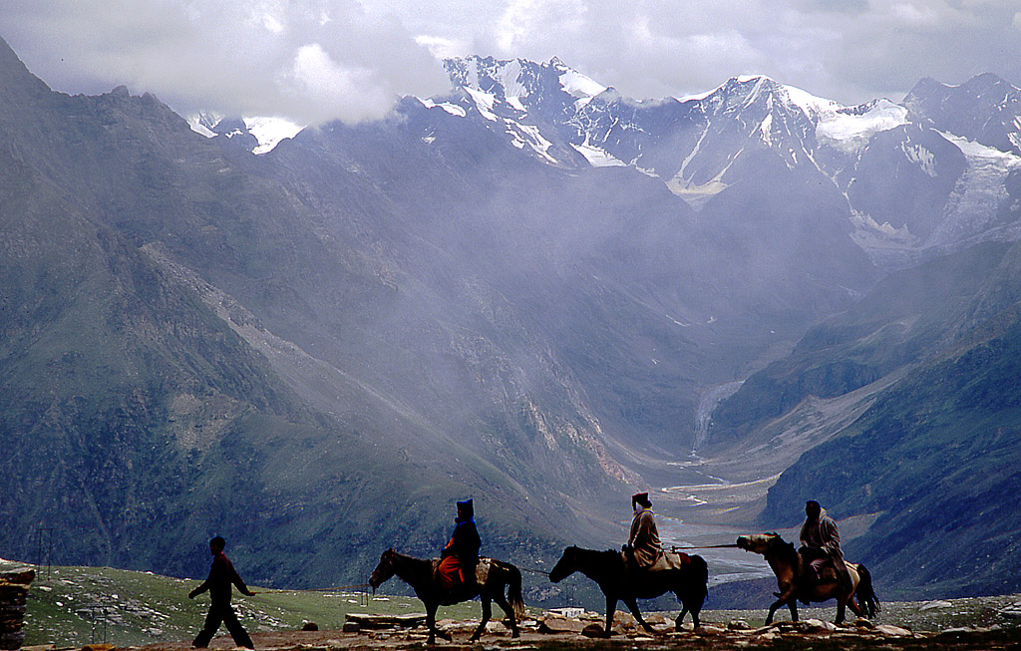

Slide 6
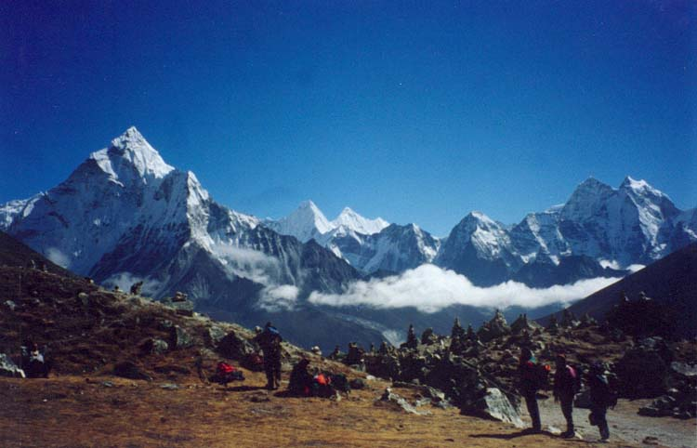

Slide 7
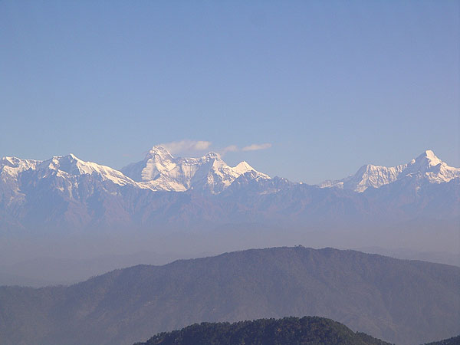

Slide 8
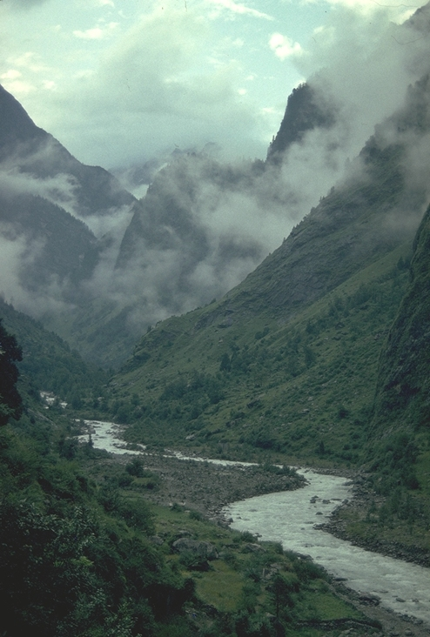

Slide 9
Identification of Geographic Features in India
Indus River
Ganges River
Peninsula and/or Subcontinent

Slide 10
Himalayan Mountains
This peninsula is surrounded on the north and northwest by huge mountains, the Himalayan Mountains.
This has often limited India's contact with other cultures. This is known as cultural isolation.
You decide! How would isolation impact the people on Ancient Indus?

Slide 11
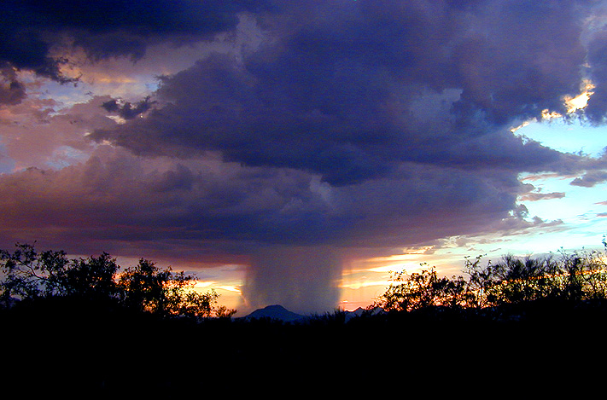
Seasonal winds known as monsoons bring rain every summer. India is dependent upon monsoons to grow their crops. Not enough rain brings drought. When there is too much rain, rivers rise and cause deadly floods and destruction of crops.

Slide 12
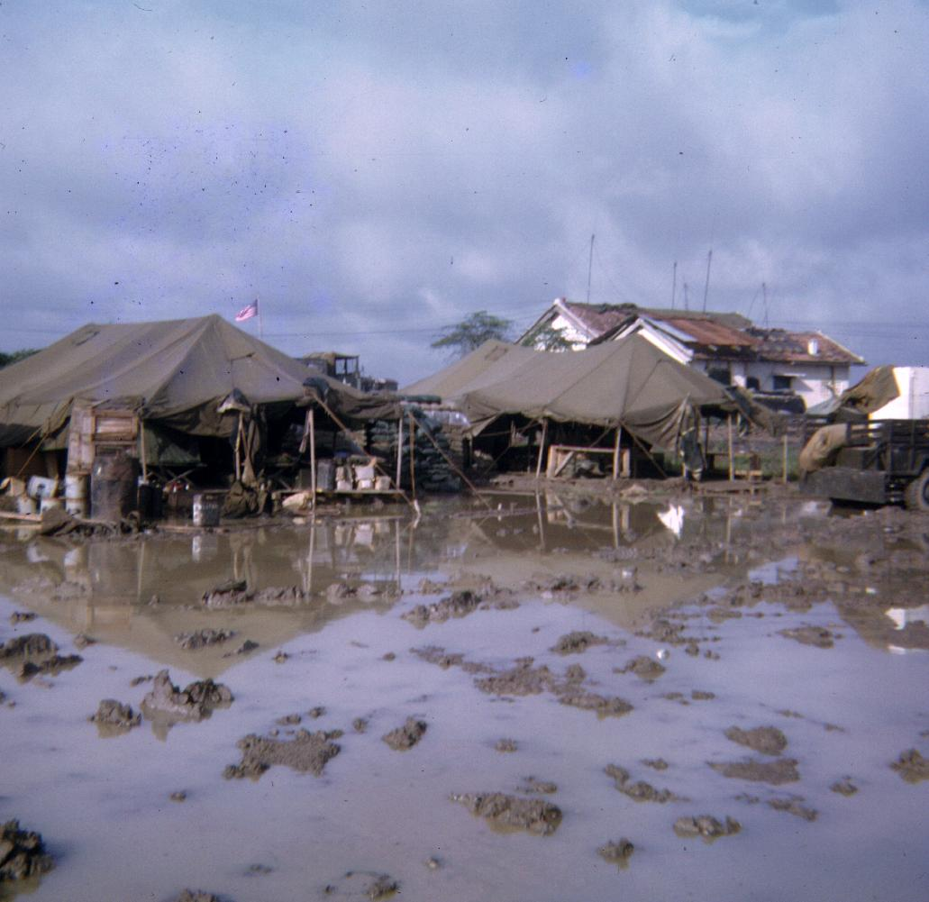

Slide 13
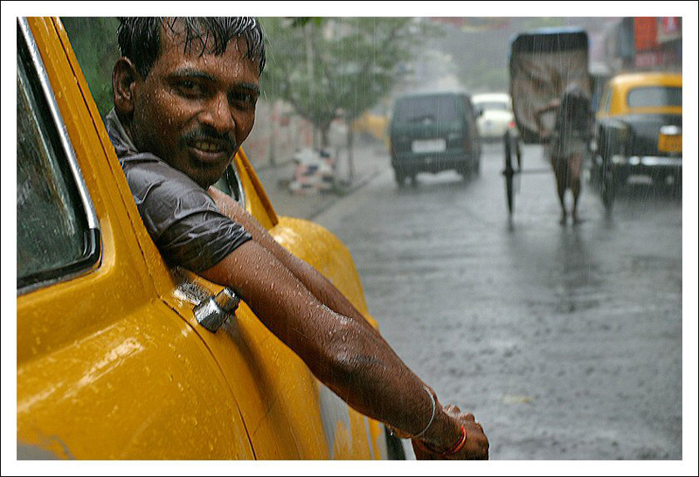
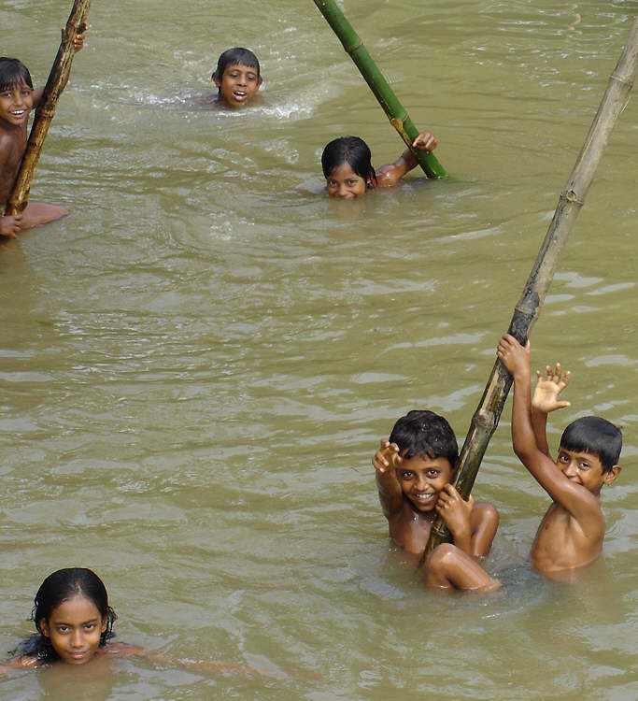
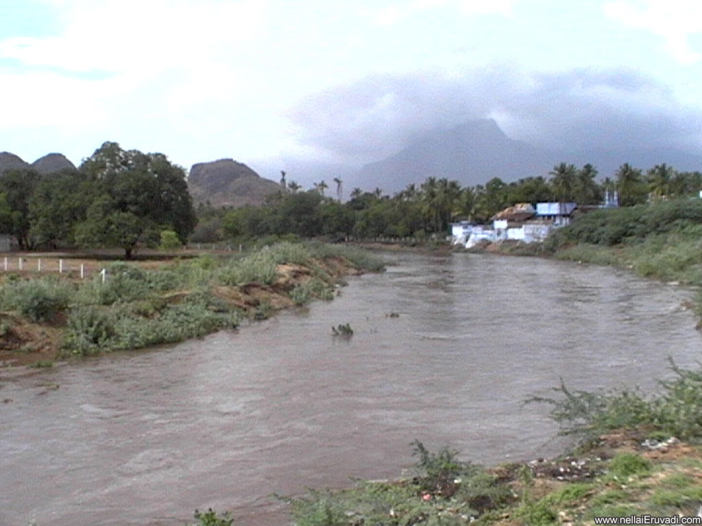

Slide 14
Civilization in the Indus River Valley Begins
About 2500 BC, about the time when the pyramids were rising in Egypt, the first Indian civilizations were forming in the Indus River Valley.
Little is known about these civilizations, but Harappa and Mohenjo-Daro were most likely twin capital cities.

Slide 15
Purpose of Early Cities
Each city was large in area and contained a large structure located on a hilltop.
Many believe these structures could have served as a fortress or even a temple.

Slide 16
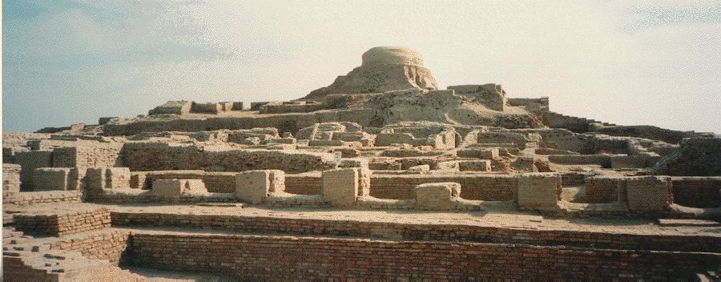

Slide 17
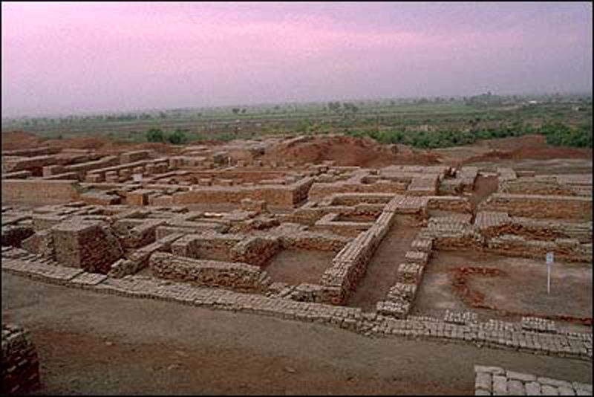

Slide 18
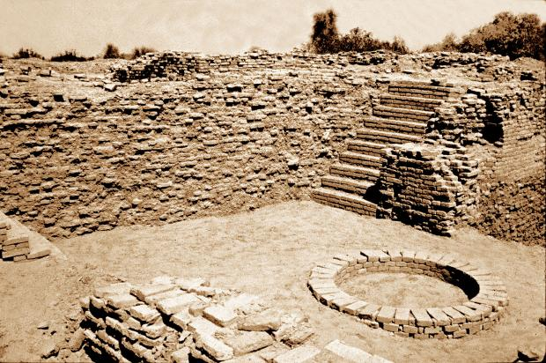

Slide 19
Film: Early History of India

Slide 20
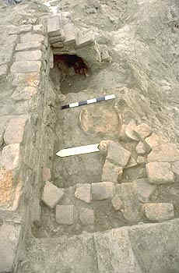
Complexities of the Cities
The most historically striking feature of these two cities were the way in which they were both well planned.
Each city was laid out in a grid pattern, the blocks similar to those seen in modern cities.
The homes seem to have been built with bricks and in a pattern repeated throughout the city.

Slide 21
Plumbing In the Cities
In addition, these cities seem to contain houses with plumbing systems, including baths, drains and water pipes.

Slide 22
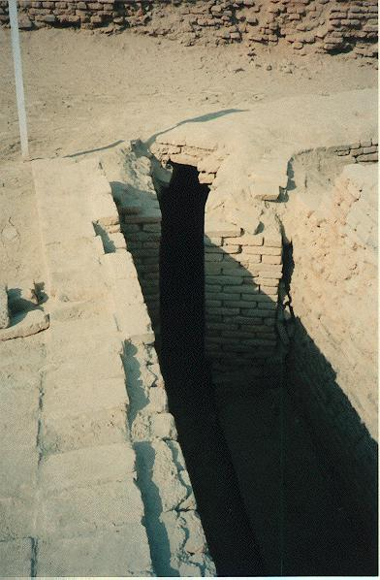

Slide 23
Trade with Sumer
Most of the people of the Indus valley were farmers. They were the first people to grow cotton and weave it into cloth.
There is early evidence of trade with other civilizations including Sumer.

Slide 24
Aryans Take over Indus Valley
Just like not much is known about the development of this region, not much is known about its decline.
For unknown reasons, around 1750 B.C. the Indus Valley began to decline. Then about 1500 B.C., nomadic warriors known as the Aryans conquered the Indus Valley.

Slide 25
“The Ruins Keep Some Secrets”
Begin Reading Now & Finish for Homework!
Questions 1-5.
Make sure to use complete sentences!

Slide 26
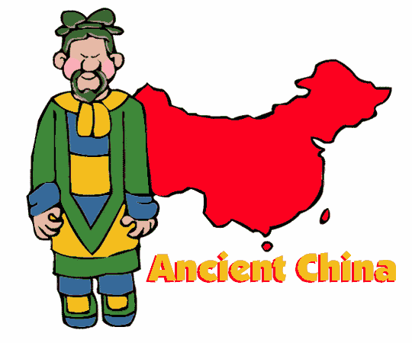
Huang He River Valley

Slide 27
China’s Geographic Features
Huang He or Yellow River
~ Chinese civilization grew up in the river valley of the Huang He River (a.k.a.the Yellow River) and the Yangzi River.
Yangzi River

Slide 28
Huang Ye River or Yellow River

Slide 29
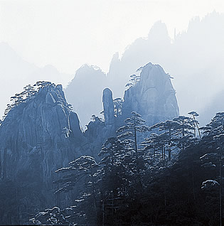
The mountains, deserts, jungles and other geographic features have isolated Chinese culture. Having little contact with others , the Chinese believed their culture was the center of the earth.

Slide 30
~ Although China covers a huge area, until recent times, most people lived only along the east coast or in the river valley.

Slide 31
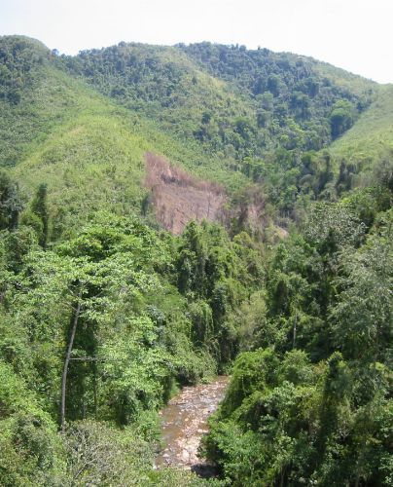

Slide 32
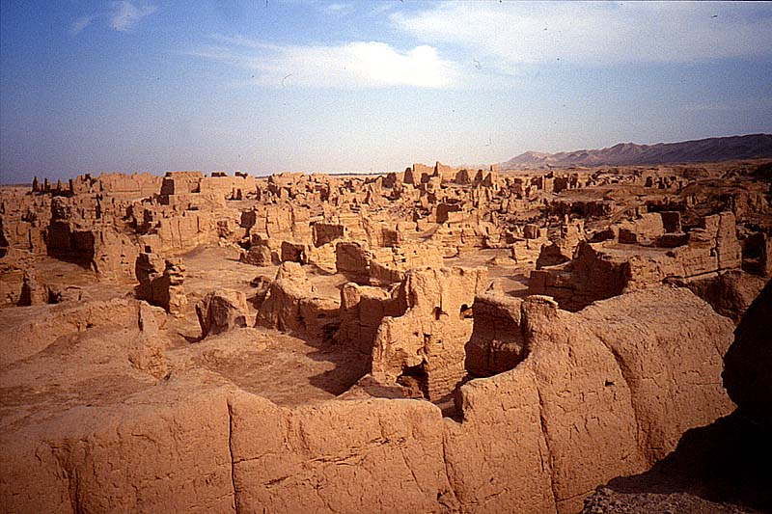

Slide 33
Early Views
The Chinese called themselves “The Middle Kingdom” because they believed they were at the center.
This is an example of ethnocentrism.

Slide 34
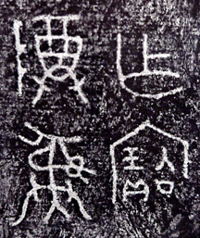
Shang Dynasty
About 1650 BC, the Shang gained control of northern China. Ruling families began to gain control, similar to small kingdoms.
The Shang set up the first dynasty.
Dynasty: A series of rulers from a family.

Slide 35
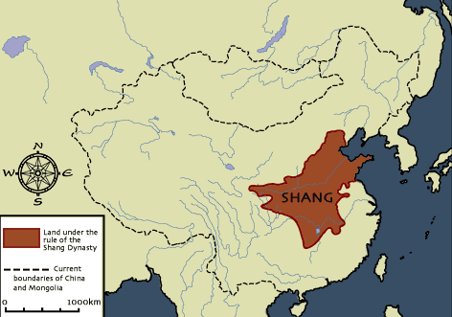

Slide 36
The ancient civilization was much like others with nobility owning the land, merchants and craftspeople trading and living in the cities and a large population of peasants living in surrounding villages.

Slide 37
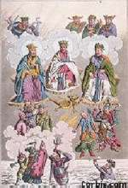
Polytheistic Peoples
Early Chinese people were polytheistic, and prayed to many Gods and nature spirits.
They also looked to dead relatives to help them in daily life and to help them please the Gods.

Slide 38
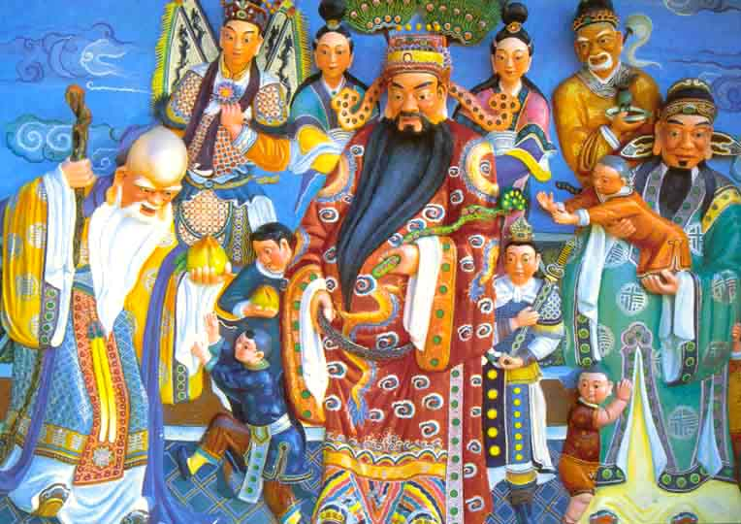

Slide 39
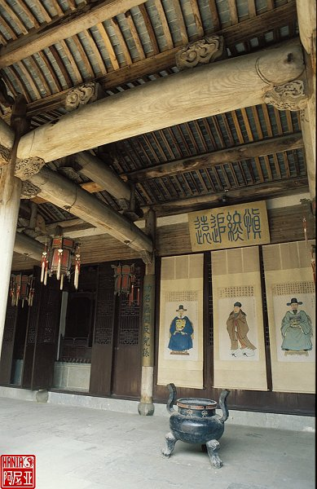
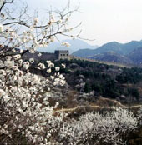
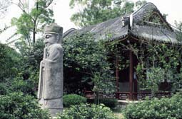

Slide 40
Ying and Yang
Many Chinese also believed that the universe held a delicate balance between opposing forces.
The Ying and Yang must be in balance for prosperity and happiness to occur in one’s life.

Slide 41
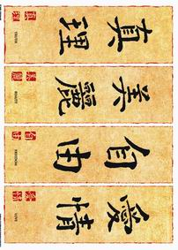
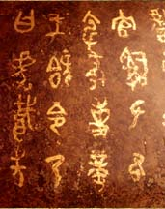
Early Writing System
The Chinese civilizations made achievements in early writing systems that include both pictographs and ideographs and is now as one of the earliest writing systems.

Slide 42
